Slide 1

How to Improve Our Company’s Attrition Rate
Through data analysis of our employee records
Afreen Siddiqui
Bruce Kimbark

Slide 2
Overall Turnover Rate
Our Attrition Rate last year was 16.1%.
Of our total employee count of 1,470, we had 237 leave the firm.
This is an extraordinarily high number which leads to costs in both production, new hire training, and employee morale. We need to do better.
By analyzing the data we have collected on all our employees, our hope was to find trends and a way to identify those employees likely to leave. We believe we have done that.
With this information in our possession, we can start to make changes here that will help employee retention and improve Uno Solutions moving forward.

Slide 3
Job Related Indicators
Salary, Overtime, Role, Specialty

Slide 4
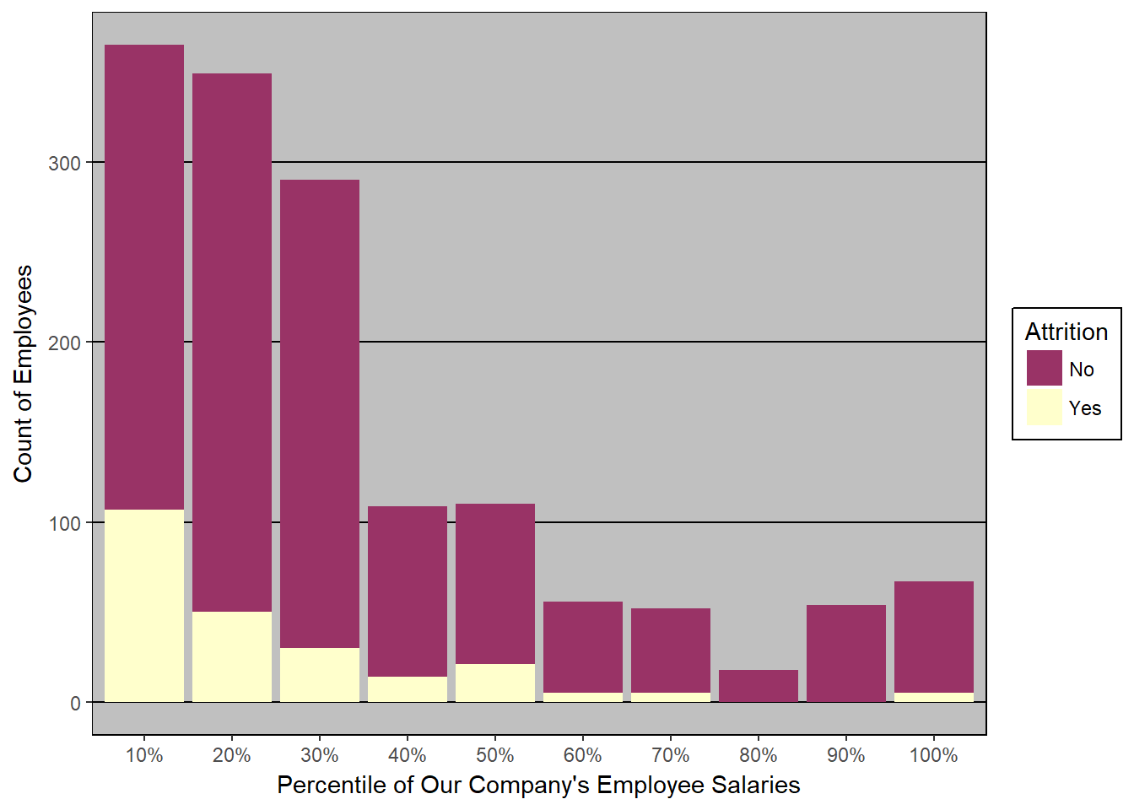
Monthly Income
The attrition in absolute terms decreases as the salary increases, thus lower salary is contributing towards attrition.
This shows negative correlation between salary and attrition. The less we pay our employees the more likely they are to leave.

Slide 5
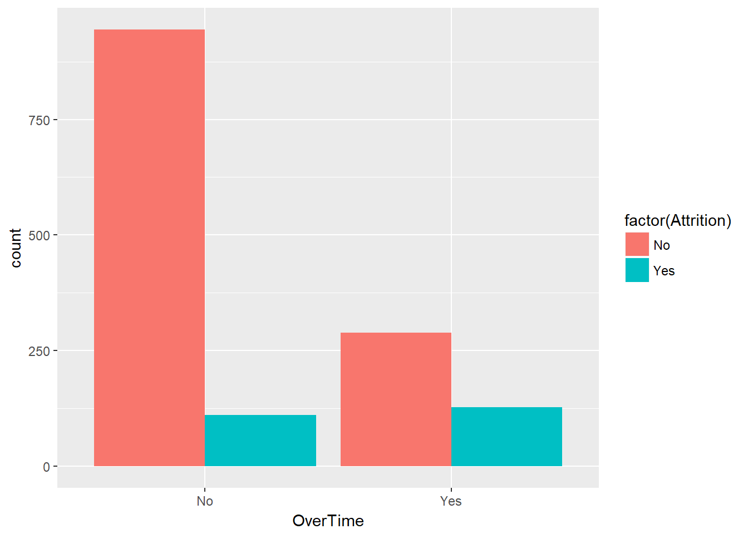
Unhappiness Regarding Overtime
As the chart to the right shows, those employees who work overtime are much more likely to leave.

Slide 6
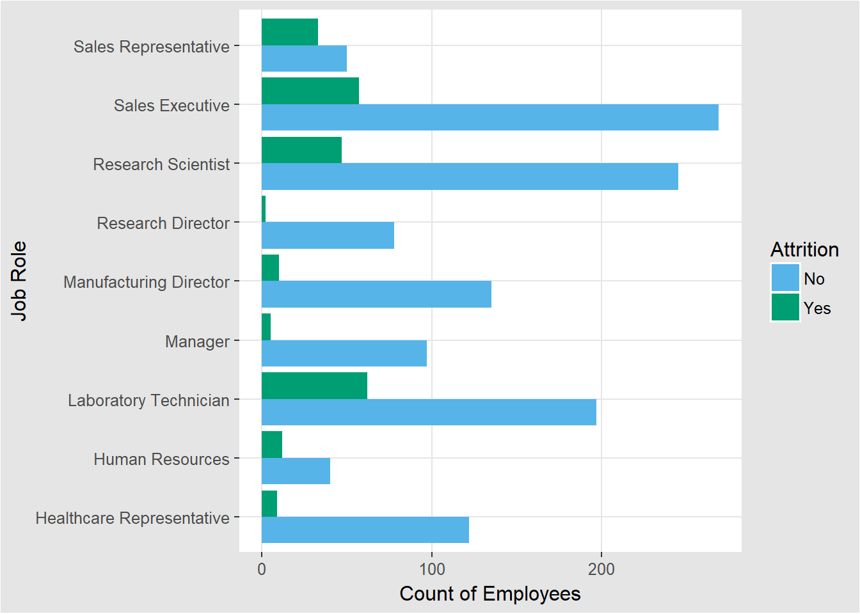
Job Role
Laboratory Technicians followed by the Sales Executives are contributing the maximum towards attrition.
In percentage terms, Sales Representative are far ahead at 66%.

Slide 7
Income vs Department
Sales department has the highest Average Income.
The employee who left the company has the lesser than average salary for their respective department.
Employees with higher salaries are with the company

Slide 8
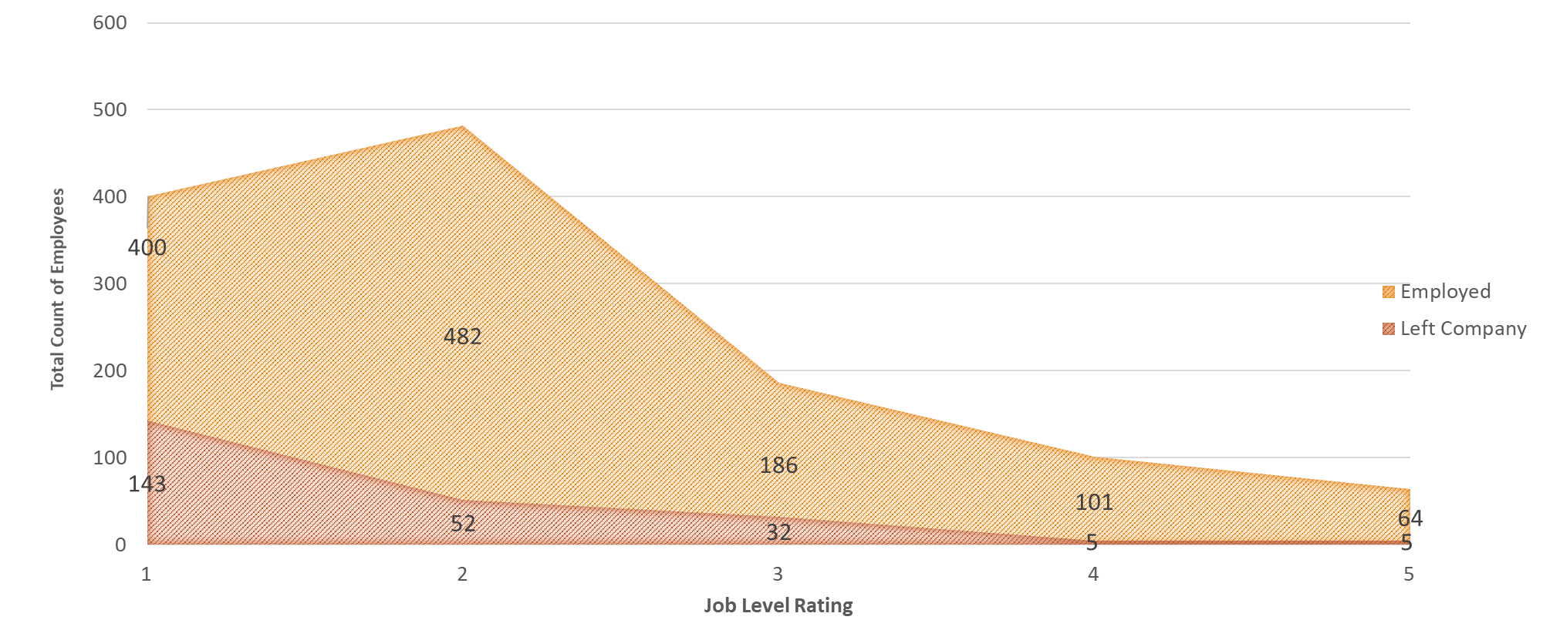
Who Left or Stayed vs Job Level Rating
Those with entry level jobs and lower titles leave at a very high rate.
Whereas those who we have in leadership and management positions have stayed with the company.
We should promote those who are the best employees as quickly as possible for the best chance to hold onto them.

Slide 9
Personal Factors
Age, Years worked, marital status

Slide 10
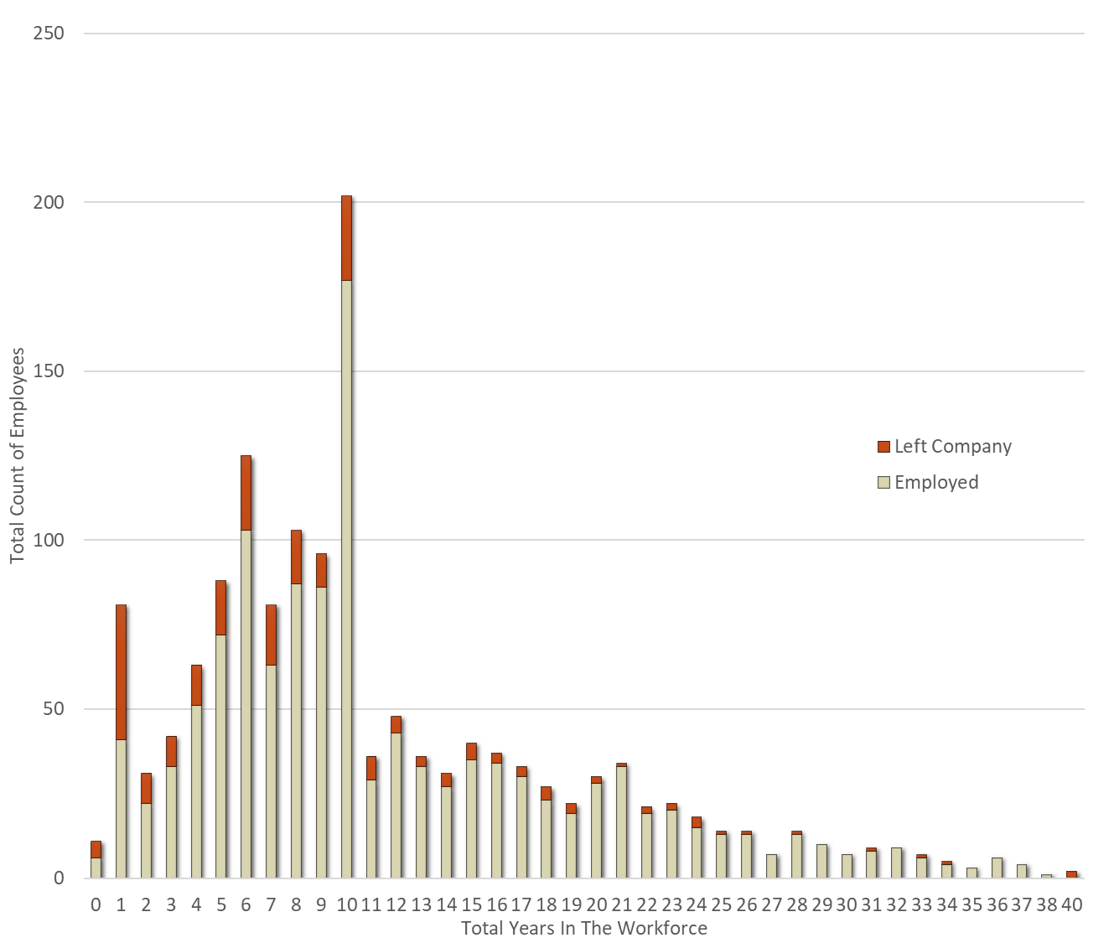
Employees Total Working Years and When They Left
An overall view of our employee base.
Our attrition rates are around 50% for employees under 2 years experience but this is expected.
The attrition rate is also expectedly low for those later in their careers.
We are concerned with those between 2 and 11 years of experience.

Slide 11
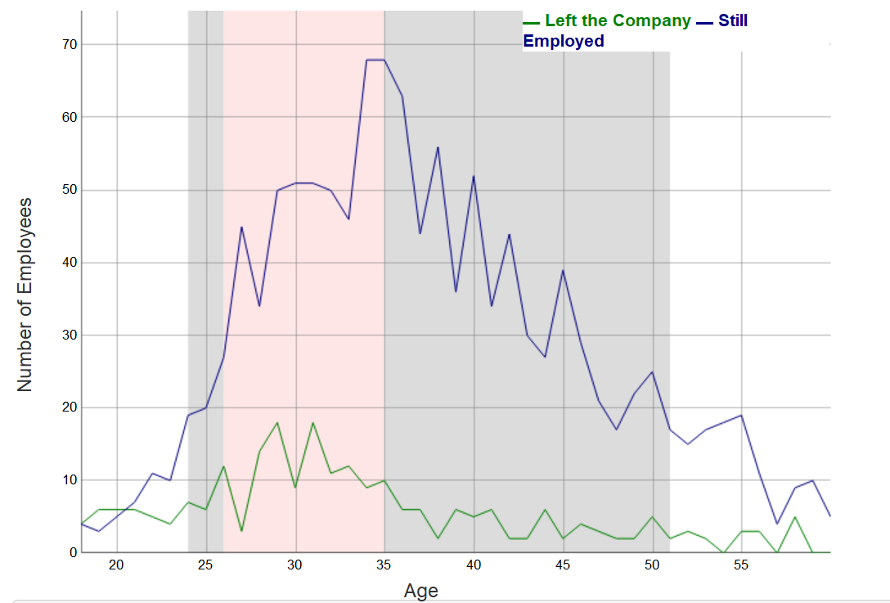
Attrition by Age
Attrition spikes between the ages of 26 and 35.
The 26 to 35 age group represents 41.22% of our total employee base.
86.73% of our employees are between the ages of 24 and 51.
We want to hold onto as many of these employees as possible especially since these are their most productive years in the workforce.

Slide 12
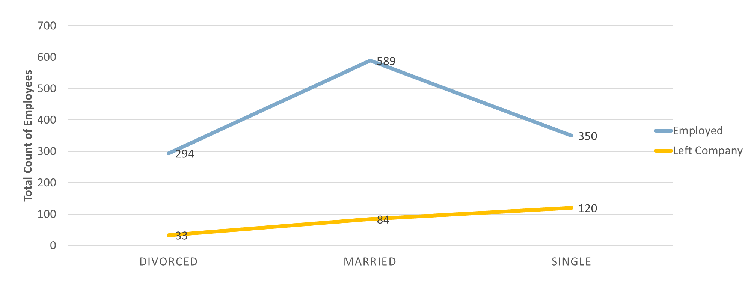
Turnover by Marital Status
Those Divorced and Married have very low attrition rates but those Single have incredibly high turnover.
This is obviously out of our control but a data point we can use to identify chance of leaving.

Slide 13
Variables that Do Not Have an Impact that would be expected to

Slide 14
College Educational Background
Most of our employees have schooling in Life Sciences and Medical followed by Marketing.

Slide 15
Analysis Using All Varying Data Points

Slide 16
Our Data Has 37 Variables
Data we can use
Data we cannot

Slide 17
Our Method
Will type this later
Benefits/Flaws

Slide 18
What we were able to determine is a Fairly Accurate Attrition Rate

Slide 19
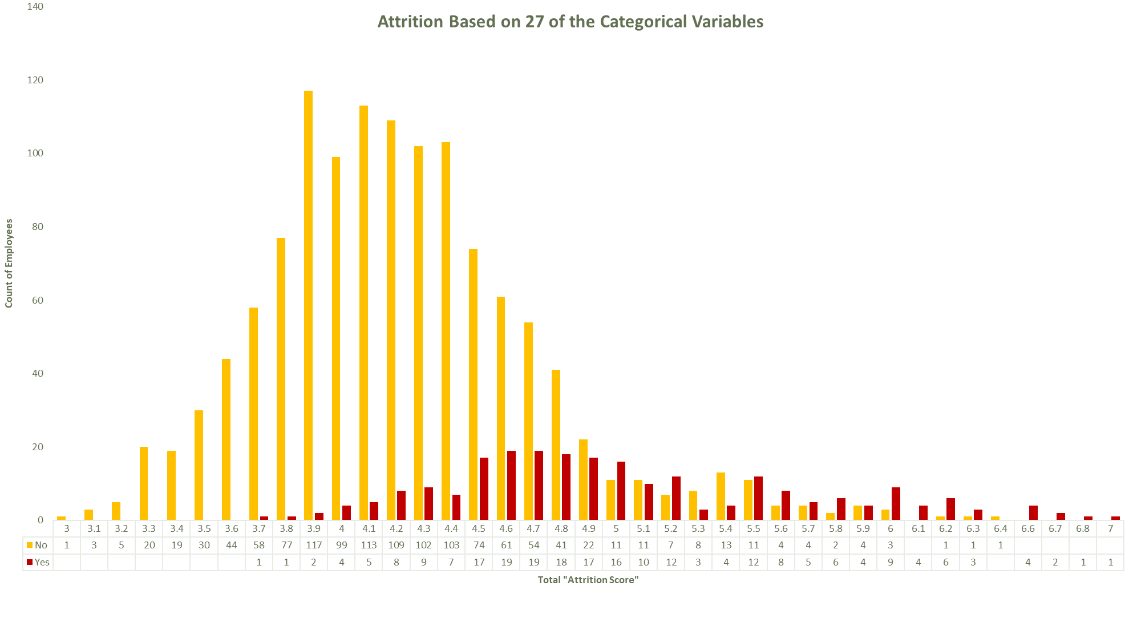

Slide 20
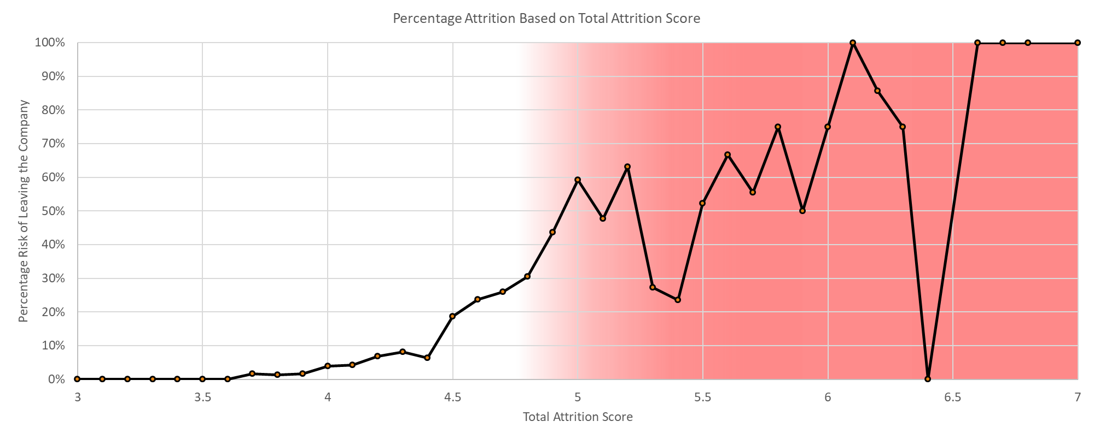
Percentage Attrition Based on the Attrition Score
For a Total Attrition Score of 5 or higher, we can expect 50% to 100% of those employees to leave the firm.

Slide 21
Conclusion
Overtime is the singlemost important factor contributing towards attrition.
Young people with lesser years at the company contribute to the attrition.
Employee with lesser salary contribute to the attrition.
Laboratory Technicians followed by Sales Executives contribute to the attrition.

